Slide 1
Work In Progress

Slide 2
Week3 - Learning
Three decision making models
The rational actor model - assumes an organization makes rational decisions.
The organizational process model - complex organizations have standard way of doing things. Leaders break down a problem into pieces, assign it to "right" departments.
Bureaucratic politics - where you stand depends on where you sit inside the organization

Slide 3
Week3 – Learning1 – Decision making
Decision making – example
Back in 2011 Magnitude 9.0 earthquake hit the northern part of Japan. Tsunami followed the earthquake and washed away thousands of people.
I was in Tokyo which is about 150 miles away from the epicenter.
One of the biggest problem was a nuclear reactor. Tsuanmi disabled the pumps which were supposed to cool down the nuclear reactors.
The insufficient cooling led to three nuclear meltdowns and the release of radioactive materials.
Japanese government was pressed to take immediate action but very slow in sharing information and indecisive in making decisions

Slide 4
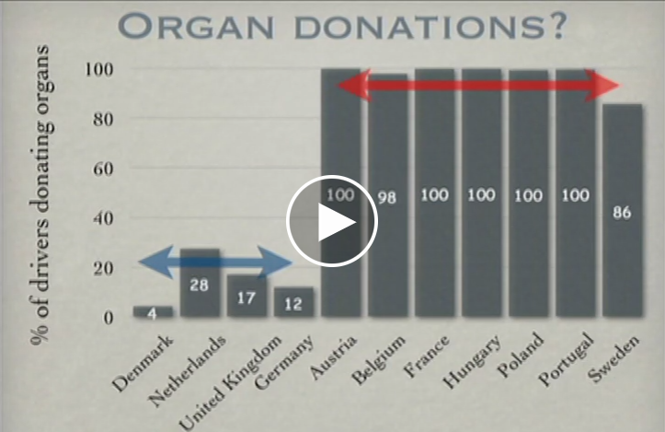
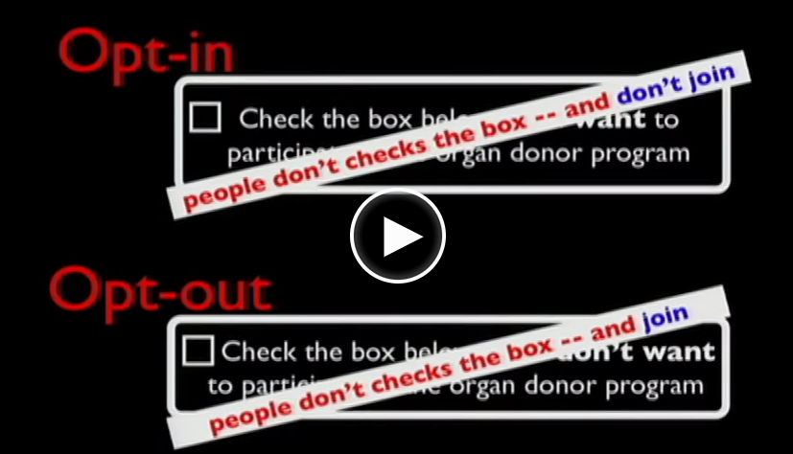
Week4 – Learning1
“A form is shaping our decisions”

Slide 5
Week4 – Learning2 – Various
Self serving bias – attribute success to themselves and failure to others
Ambiguity effect – prefer some decision options that have much more information than others.
Endowment effect – because of loss aversion, you find it harder to part with what you own than to acquire the equivalent thing
Hindsight bias -

Slide 6
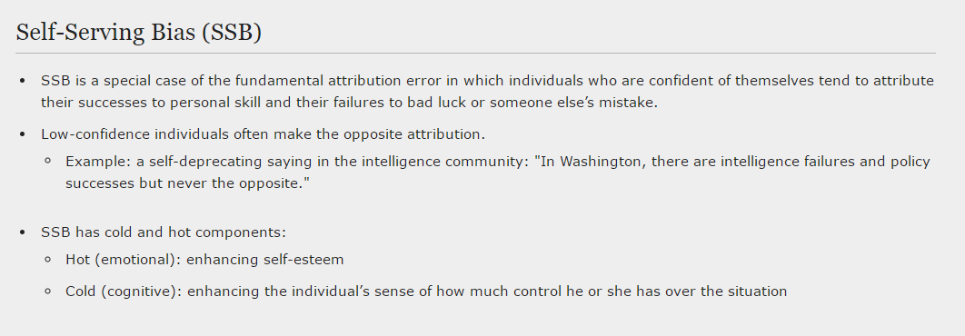
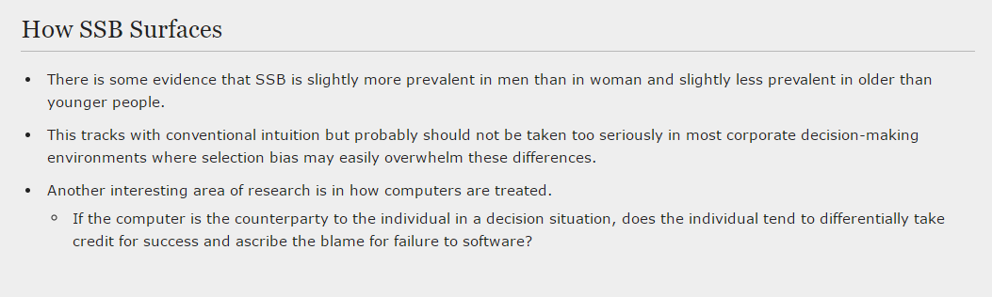

Slide 7
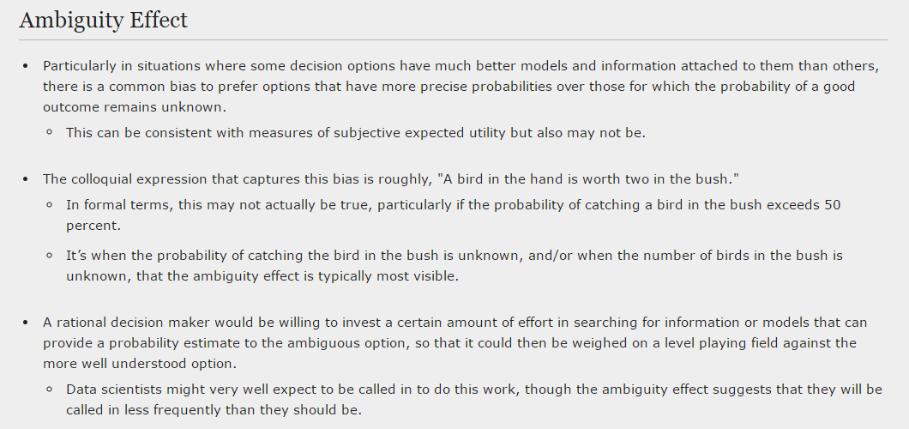

Slide 8
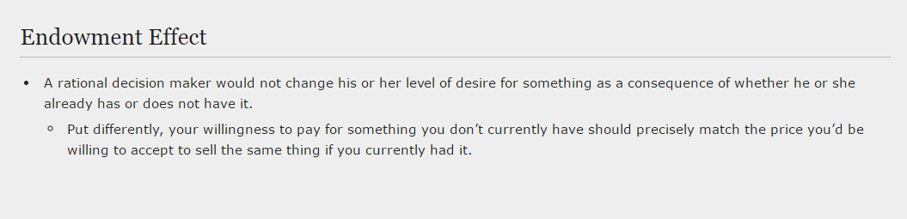
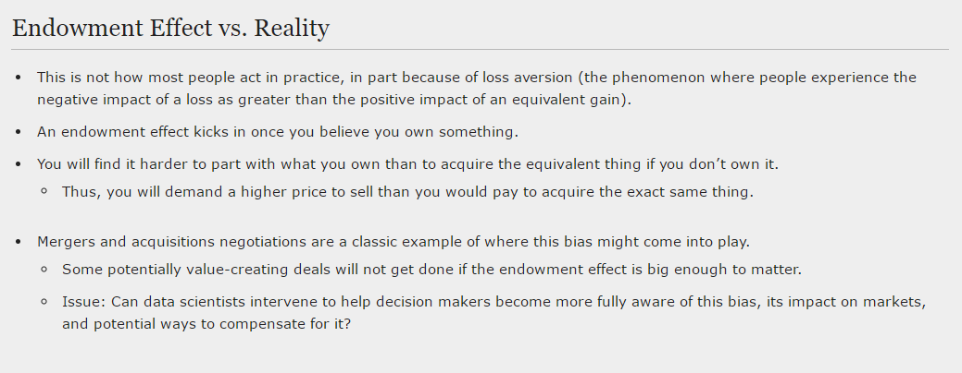

Slide 9
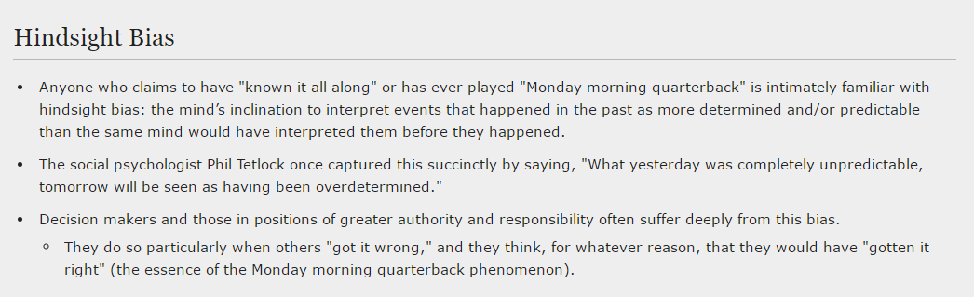

Slide 10
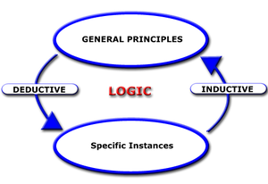
Week6 Induction vs. Deduction

